Slide 1

Chapter 23. Effective Buffer Utilization
Database Design and Implementation
Edward Sciore, Boston College
ISBN: 978-0-471-75716-0
Presented by Liping Guan
liping0223@korea.ac.kr
Data Intelligence Laboratory, Korea University
19th May, 2015

Slide 2
Outline
23.1 Buffer Usage in Query Plans
23.2 Multibuffer Sorting
23.3 Multibuffer Product
23.4 Implementing the Multibuffer Operations
23.5 Hash Joins
23.6 Comparing the join Algorithms

Slide 3
23.1 Buffer Usage in Query Plans
Buffer Usage
Materialize
In Chapter 22, it requires one buffer for temporary table
Sort
Its implementation requires one or two additional buffers
Merge
It requires k+1 buffers, k merged, one for result table
A machine has 40 MB for buffers, 10,000 4KB buffers

Slide 4
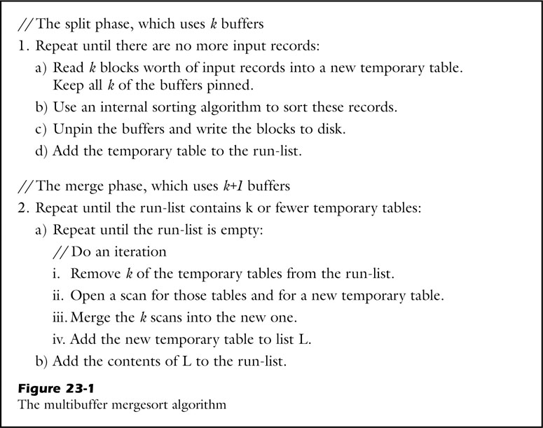
23.2 Multibuffer Sorting
1. Splits the records into runs
2. Merge the runs until table is sorted
k blocks
table
k blocks
table
k blocks
table
run list
table
New temporary table
table
table

Slide 5
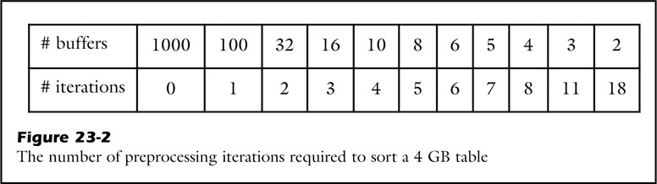
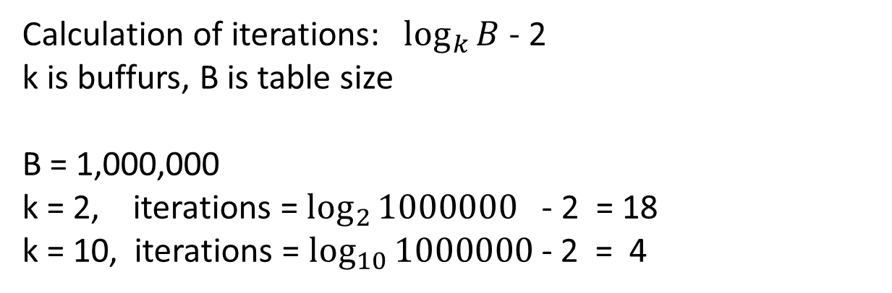
23.2 Multibuffer Sorting
Calculation of iterations:$\log_{k}{B}$ - 2
k is buffurs, B is table size
B = 1,000,000
k = 2, iterations = $\log_{2}{1000000}$ - 2 = 18
k = 10, iterations = $\log_{10}{1000000}$ - 2 = 4

Slide 6
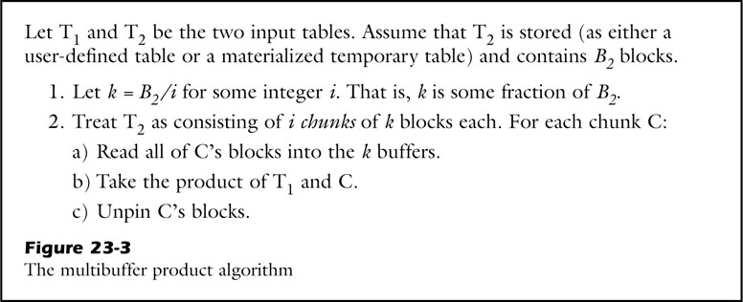
23.3 Multibuffer Product
Implementation of product is expensive
Product (T1, T2)
Example:
T2 = 1000 blocks, buffers = 500 blocks
Read T1 twice, T2 once
T1
T2
T1
T2

Slide 7
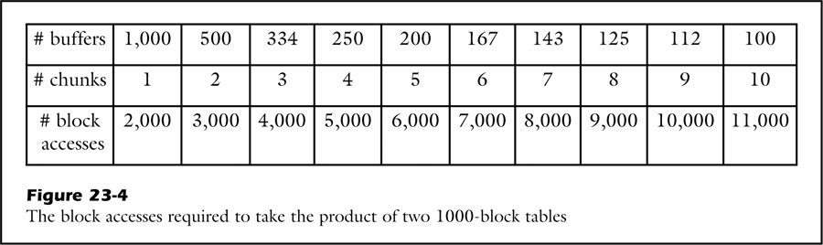
23.3 Multibuffer Product
Calculation of block access: B2+ B1*B2/k
T1 = 1000-block table, T2 = 1000-block table (B1=B2=1000)
k = 1000, chunks = B2/k =1, block access = 1000+1000 = 2000
k = 100, chunks = B2/k =10, block access = 1000+1000 = 11000

Slide 8
23.4 Implementing the Multibuffer Operations
Determining How Many Buffers to Use
Implementing Multibuffer Sorting
Implementing Multibuffer Product

Slide 9
Determining How Many Buffers to Use
Choose k buffers
It is determined by available buffers, size of input tables and the operator involved.
Sort
k is the size of input table
Product
k is factor of the right hand table size

Slide 10
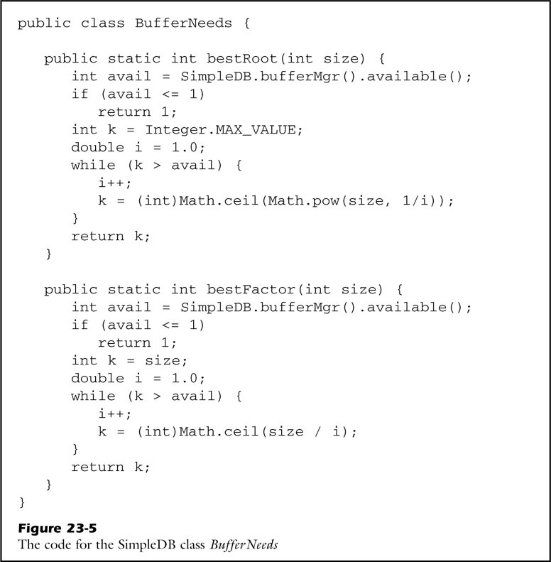
Implementing Multibuffer Sorting
SplitIntoRuns:
int size = blockAccessed();
int numbuffs =
bufferNeeds.bestRoot(size);
Allocate k buffers for merge:
int numbuffs =
bufferNeeds.bestRoot(runs.size());

Slide 11
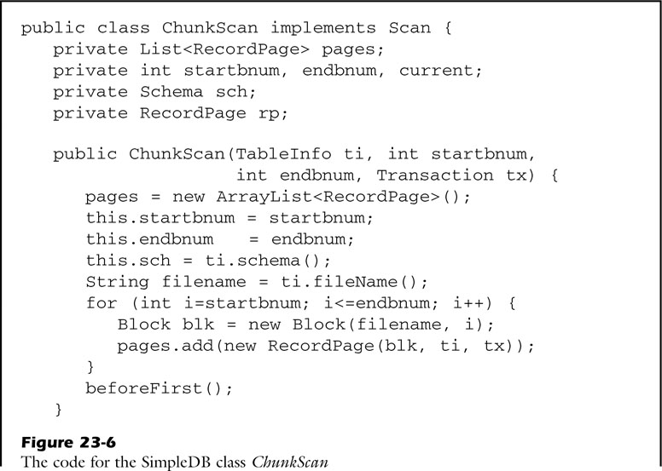
Implementing Multibuffer Product
chunk:
k-block materialized table
Constructor:
Sorted table,
First and last block number in this chunk

Slide 12
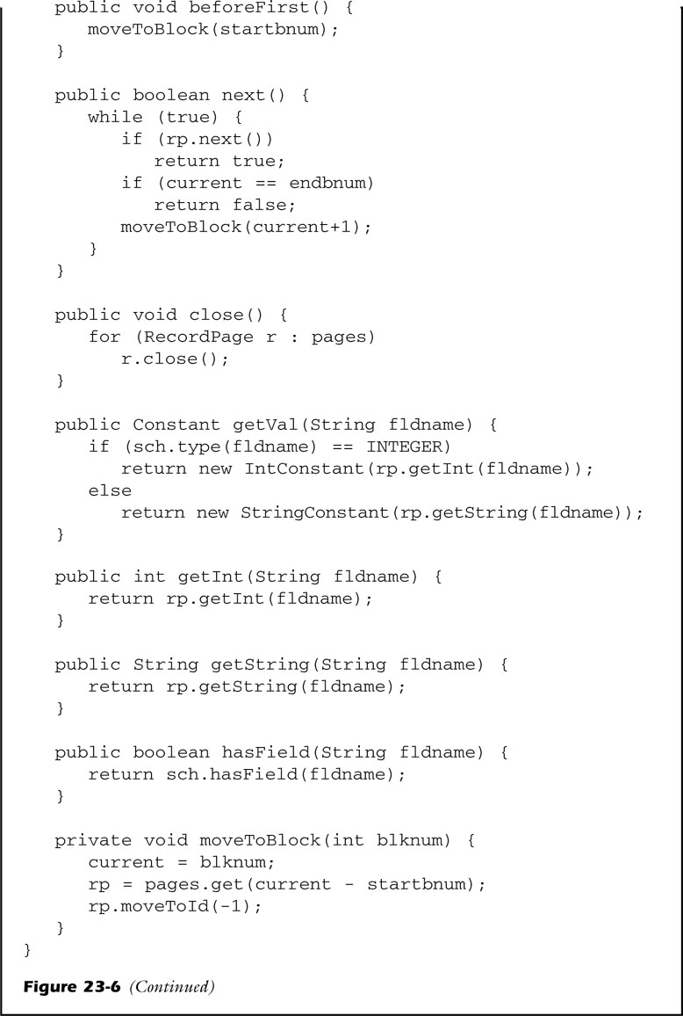
next()
Move to next record in current page
If current page has no more records, next page becomes current
Moving block in chunk does not close previous record page

Slide 13
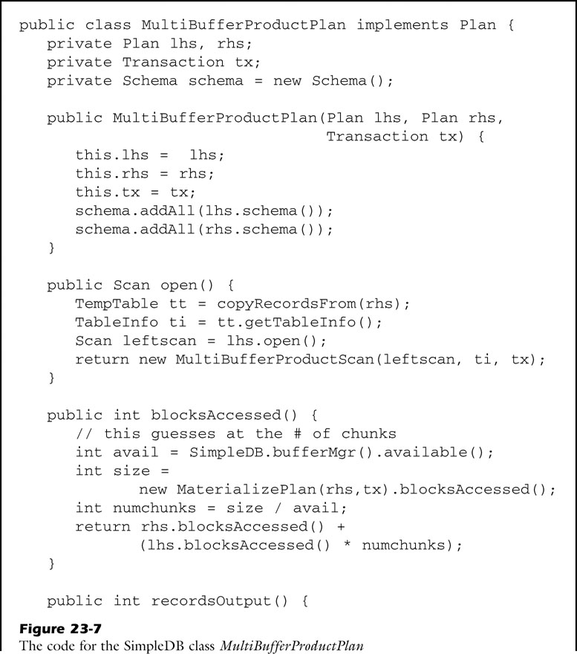
open()
Materialize right side records into temporary table
Then open scan on left side
Parse scan and table to constructor
Chunk number

Slide 14
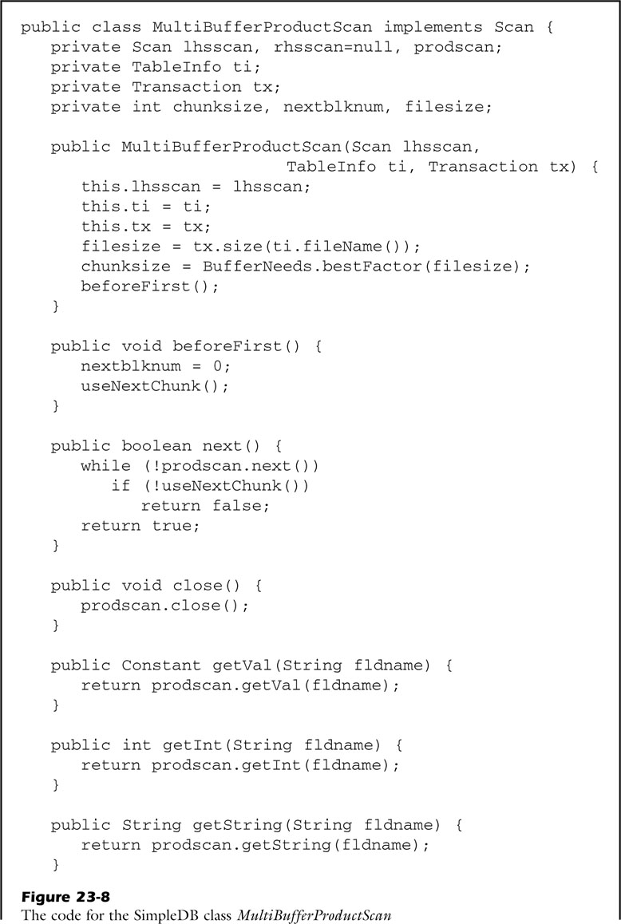
Use tx.size to get actual file size,
Pass file size to bestFacot to get chunk size

Slide 15
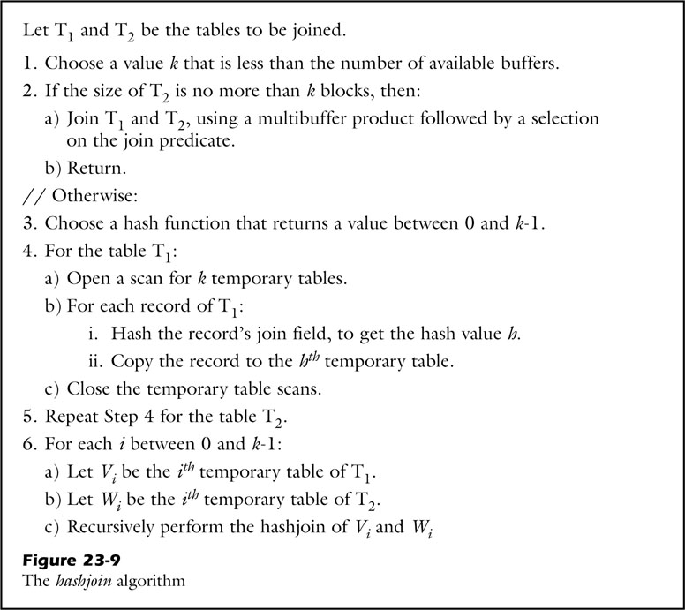
23.5 Hash Joins
22.6 introduce mergejoin,
This is different join algorithm: hashjoin
Difference:
Mergejoin
Cost depends on larger input table
hashjoin
Cost depends on smaller input table

Slide 16


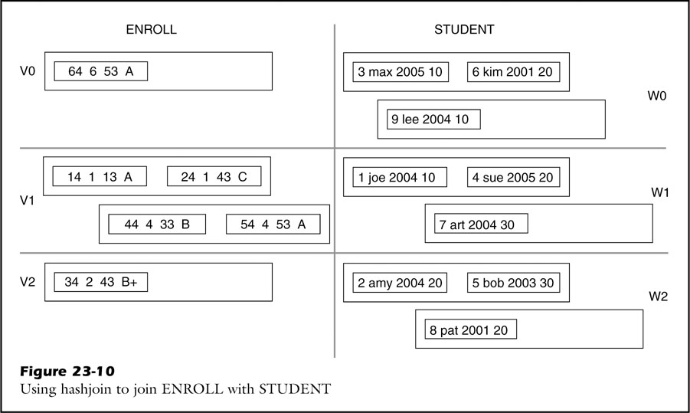
Example of Hashjoin
Student table on right
Two records in one block in Student table
Number of Buffer: k = 3
hash function
H(n) = n%3

Slide 17
Comparing the join Algorithms
Query: select Sname, Grade from STUDENT, ENROLL where SId = StudentId
Efficient:
Hashjoin > Mergejoin > Indexjoin
Reason:
Student table is much smaller than number of buffers
and Enroll table
indexjoin is not useful when there are too many matching data records

Slide 18
Q&A

